Slide 1


Slide 2

Python Programming Bootcamp - Week 4, Day 01
Introduction to File Handling
Atta Muhammad
attapanhyar@quest.edu.pk
+923331971110
Quaid-e-Awam University of Engineering, Science and Technology

Slide 3
Learning Objectives
Understand the basics of file handling in Python.
Learn how to open, read, write, and close files.
Understand different modes of file handling (read, write, append).
Handle exceptions while working with files

Slide 4
Why Learn File Handling?
Definition: File handling is essential for data storage, processing, and analysis.
Applications: Saving user data, logs, reading configurations, and exporting results.

Slide 5


Opening and Closing Files
Opening a File
Closing a file

Slide 6
File Modes in Python
Read Mode ('r'): Opens a file for reading.
Write Mode ('w'): Opens a file for writing (overwrites content).
Append Mode ('a'): Opens a file for appending new content.
Binary Mode ('b'): Used for binary files (e.g., images).
Read Mode ('r'): Opens a file for reading.
Write Mode ('w'): Opens a file for writing (overwrites content).
Append Mode ('a'): Opens a file for appending new content.
Binary Mode ('b'): Used for binary files (e.g., images).

Slide 7
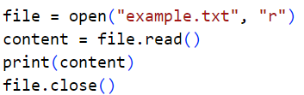
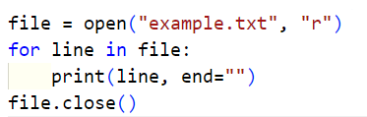
Reading Files
Reading the Entire File:
Reading Line by Line:

Slide 8


Writing to Files
Writing Data to a File:
Appending Data to a file

Slide 9
Hands-On Exercise 1
Task: Write a Python program that reads the content of a file named students.txt and prints each line.

Slide 10

Using with Statement
Advantage: Automatically handles file closing, even in case of exceptions.

Slide 11
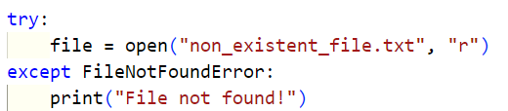
Handling File Exceptions
Catching Errors:

Slide 12

File Pointer and tell() & seek() Methods
Understanding the File Pointer: Tracks the current position in the file.

Slide 13
Hands-On Exercise 2
Task: Write a Python program that writes user input to a file and then reads it back.

Slide 14

Reading and Writing Binary Files
Binary Files: Used to handle non-text files such as images, videos, or executables.

Slide 15
Hands-On Group Activity
Task: Create a program that reads from a file data.txt and writes the reversed content to a new file reversed.txt

Slide 16
Recap and Key Takeaways
Files can be opened in different modes (r, w, a, b).
Always close files or use the with statement to handle them automatically.
Exception handling is important to manage errors during file operations.

Slide 17

Questions ?

Slide 18
MATCH THE SOLUTIONS 😒

Slide 19
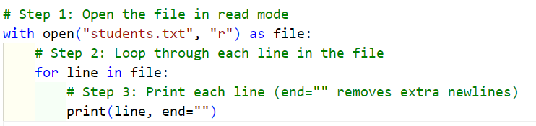
EXERCISE 🫥

Slide 20
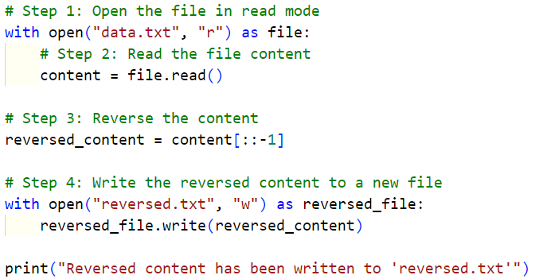
Exercise 🧑‍💻

Slide 21
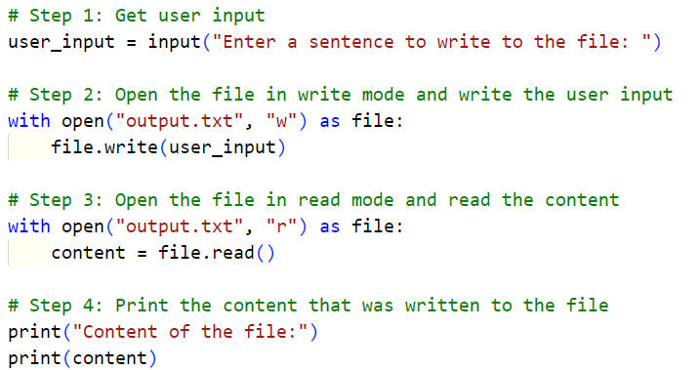
Exercise 💎

